Slide 1


JPA & Hibernate ORM
Mastering modern Java persistence, relationships, and data access patterns.

Slide 2
Objectives
1. Core JPA Annotations
2. Hibernate ORM
3. JPQL and Criteria API
4. Repository Pattern

Slide 3





Core JPA Annotations
@Entity
@Id
Relationships
Defines a class as an entity to be mapped to a database table. It represents the blueprint of your data model.
Specifies the primary key of an entity. Essential for object identity and persistence context management.
@OneToMany, @ManyToOne, and @ManyToMany define how entities connect and associate with one another.

Slide 4


Hibernate ORM Concepts
Fetch Strategies
Cascade Types
Lazy Loading: Fetches related data only on demand. Improves performance by loading less data initially.
Controls how state changes propagate from parent to child entities.
Eager Loading: Fetches related data immediately with the parent. Useful when associations are always needed.
Persist: Save child when parent is saved.
Remove: Delete child when parent is deleted.
Merge: Update child when parent is updated.

Slide 5


Querying: JPQL & Criteria API
JPQL (Java Persistence Query Language)
An object-oriented query language similar to SQL but operating on JPA entities rather than database tables.
Criteria API
A programmatic, type-safe way to define dynamic queries using Java objects. It prevents syntax errors at runtime and is ideal for complex, dynamic filtering.

Slide 6

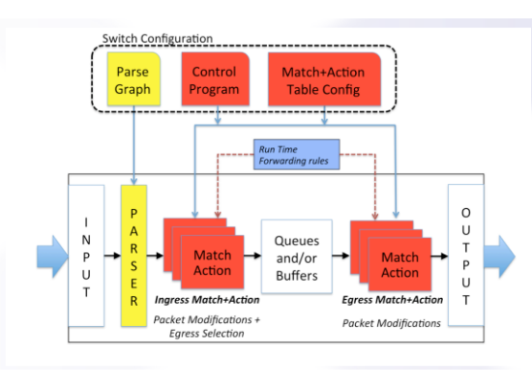
The Repository Pattern
Abstraction Layer
The Repository pattern mediates between the domain and data mapping layers using a collection-like interface for accessing domain objects.
Benefits
•
Decouples business logic from data access details.
•
Simplifies unit testing by allowing easy mocking of data.
•
Centralizes data access logic (CRUD operations).

Slide 7

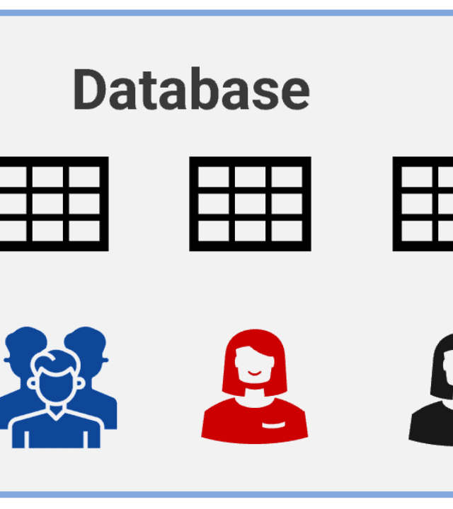
Project: JDBC Migration
Objective
Refactor the legacy JDBC layer to a modern JPA/Hibernate architecture.
Key Steps
•
Map existing SQL tables to @Entity classes.
•
Replace raw ResultSet parsing with Hibernate Repositories.
•
Implement Transaction Management.
•
Optimize fetch strategies for performance.

Slide 8




Image Sources
https://media.istockphoto.com/id/1278530885/photo/computer-programming-often-shortened-to-programming-is-a-process-for-original-formulation-of.jpg?s=612x612&w=0&k=20&c=PXA24pfeUetUbOf8SPW291yrlcuG7BeV7cXfxsRiOXk=
Source: www.istockphoto.com
https://us1.discourse-cdn.com/flex019/uploads/p4/original/1X/12684c74fc73e8f9829e7f50e0c973adac5fa8e8.png
Source: forum.p4.org
https://www.red-gate.com/simple-talk/wp-content/uploads/2023/05/a-picture-containing-diagram-description-automati-1.png
Source: www.red-gate.com

